Slide 1
Image Segmentation
Superpixel methods
Speaker: Hsuan-Yi Ko

Slide 2
Outline
Introduction to superpixels
Graph-based superpixel methods
‧Ncut
‧ERS
Gradient-based superpixel methods
‧SLIC
‧Waterpixel
Conclusion
Reference

Slide 3
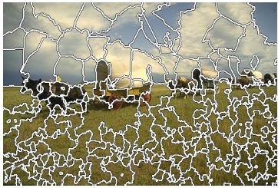
What’s the superpixel?
A cluster of connected pixels with similar features (ex: color、brightness、texture...).
It can be regarded as a result of over segmentation.
The concept was proposed in 2003 but the results of some former methods also can be called superpixels. (ex: watershed、mean shift)
Watershed [1]
TurboPixel [2]

Slide 4
Desirable Properties of Superpixels
Good adherence to object boundaries
Regular shape and similar size
Compute fast and simple to use

Slide 5
Advantage of Superpixels
Regional information
High computational efficiency

Slide 6
Superpixel Methods
Graph-based: Superpixel Lattice、Efficient Graph-based segmentation、Ncut、ERS……
Gradient-based: Watershed、MeanShift、Quick-Shift、TurboPixel、SLIC……

Slide 7
Graph-Based Methods
Normalized Cut (Ncut) [5]
Entropy Rate Superpixel (ERS) [4]

Slide 8
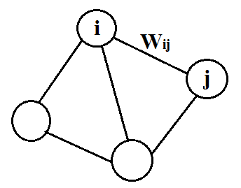
Graph Representation
Denote an undirected graph as G=<V, E> where V is the vertex set and E is the edge set.
Wij: the weight on the edge which connects node i and node j
In an undirected graph, the edge weights are symmetric, that is Wij = Wji.
undirected graph
Notes:
Example for an undirected graph

Slide 9
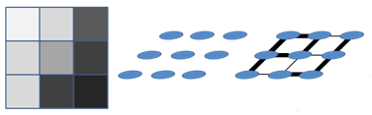
Graph-Based Segmentation
Consider an image as an undirected graph and each edge is assigned with a non-negative weight
－Treat each pixel as a node in a graph
－Edge weights are related to the similarity between
neighboring pixels.
Various techniques are formed based on this assumption and graph cut.
Consider an image as an undirected graph

Slide 10
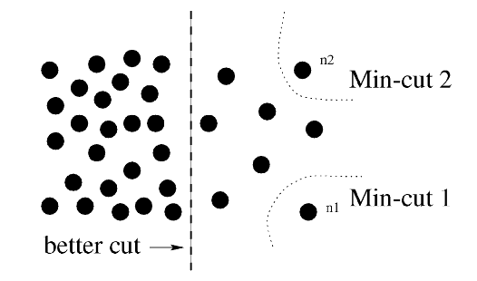
Min Cut
The cost of the cut is the sum of the weights on cut edges.
Min cut is a method of minimizing the cost of the cut, but it favors cutting small sets of isolated nodes in the graph.
[5] Shi, Jianbo, and Jitendra Malik. "Normalized cuts and image segmentation."
Notes:
[5] Shi, Jianbo, and Jitendra Malik. "Normalized cuts and image segmentation.“\

Slide 11
Ncut
the total connection from nodes in A to all nodes in the graph
Avoid the unnatural bias
Minimize Ncut to segment images
[5] Shi, Jianbo, and Jitendra Malik. "Normalized cuts and image segmentation."

Slide 12
Simulation Results
Regular and compact shape
Bad adherence to object boundaries
High computational cost especially for images with large size
The average superpixel size in the upper left of each image is 100 pixels and is 300 in the lower right.
[6] Achanta, Radhakrishna, et al. "SLIC superpixels compared to state-of-the-art superpixel methods."
Notes:
[6] Achanta, Radhakrishna, et al. "SLIC superpixels compared to state-of-the-art superpixel methods."

Slide 13
ERS
Objective function:
(1)H(A): entropy rate of a random walk on a graph
－ compact and homogeneous clusters
－ superpixels overlapping only a single object
(2) B(A): balancing term on the cluster distribution
－ clusters with similar sizes

Slide 14
Random walks on graphs
Let X = { Xt|t ∈ T, Xt ∈V } be a random walk on the graph G = (V, E) and the entropy rate can be written as
Notes:
假設X是在圖像上隨機遊走的過程，也就是在t這個時間點 位在node Xt 到了t+1 就跑到node Xt+1 這樣在圖上隨機遊走，這樣一個random walk的entropy rate可以用下面式子來表示
Wi 是和節點 i 相連邊的權重和
Wt 是整張圖上所有邊的權重和
Wij 是連接節點i和節點j的邊權重 (相似度)
Pij 是節點 i 到節點 j 的轉移概率 (i不等於j)， paper裡還有定義self loop的Pij ，這裡因為版面問題所以就沒細說了。

Slide 15
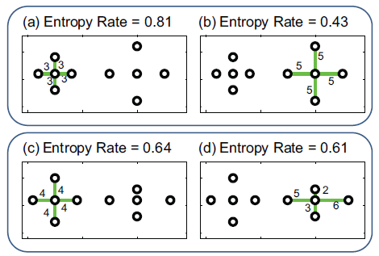
The role of entropy rate in obtaining compact and homogeneous clustering.
[4] Liu, Ming-Yu, et al. "Entropy rate superpixel segmentation."
Notes:
[4] Liu, Ming-Yu, et al. "Entropy rate superpixel segmentation."

Slide 16
Balancing Term
NA is the number of connected components
Let the graph partitioning for the edge set A be
SA = {S1, S2, ..., SNA}. Then the distribution of ZA is
equal to
Notes:
The entropy H(ZA) favors clusters with similar sizes; whereas NA favors fewer number of clusters.

Slide 17
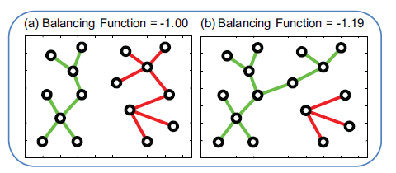
The role of the balancing function in obtaining clusters of similar sizes.
[4] Liu, Ming-Yu, et al. "Entropy rate superpixel segmentation."
Notes:
這裡是顯示當平衡項越大時，cluster的大小會越一致。
所以目標函數由Entropy rate和平衡項組成，Maximize the objective function後，就可以得到切割結果

Slide 18
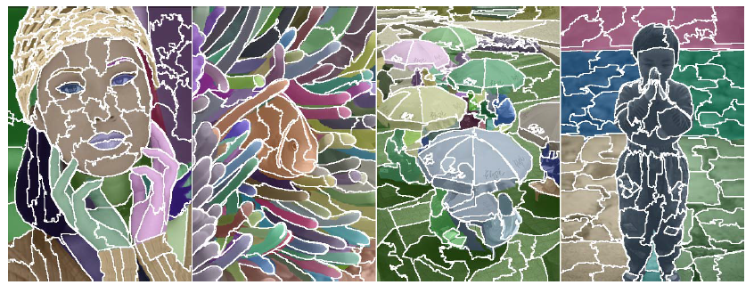
Simulation Results
Irregular shape but similar size
Good adherence to object boundaries
Fast
[4] Liu, Ming-Yu, et al. "Entropy rate superpixel segmentation."
Notes:
[4]

Slide 19
Gradient-Based Segmentation
Starting from rough initial clusters and then iteratively refine the clusters by gradient until some convergence criterion is met.
Simple linear iterative clustering (SLIC) [6]
Waterpixel [1] [8]

Slide 20
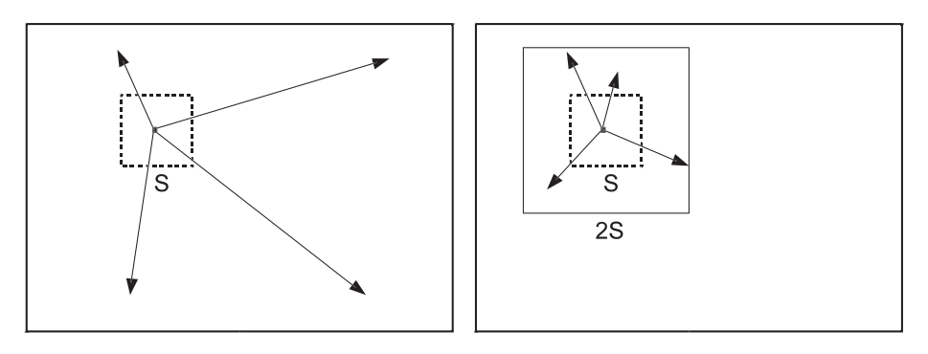
SLIC
CIELAB color space
Set initial seeds: distance S and low gradient in 3x3 window
Local clustering by k-means in 5D space
(a)
(b)
(a) standard k-means searches the entire image. (b) SLIC searches a limit region.
[6] Achanta, Radhakrishna, et al. "SLIC superpixels compared to state-of-the-art superpixel methods."
Notes:
N pixels, K superpixels，種子點距離S，避免位在edge上，所以把種子移到3x3 window內較低gradient的地方，每個種子設一個唯一的label
根據距離和LAB計算相似度D，將每個pixel分給最相似的種子並標記
m是用來衡量顏色和空間訊息在相似度的比重
只在2Sx2S的空間中進行K-means 而不是在整張圖分群

Slide 21
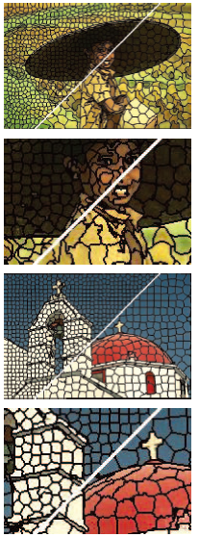
Simulation Results
Regular and compact superpixel
Fast and simple
The average superpixel size in the upper left of each image is 100 pixels and is 300 in the lower right.
[6] Achanta, Radhakrishna, et al. "SLIC superpixels compared to state-of-the-art superpixel methods."
Notes:
The average superpixel size in the upper left of each image is 100 pixels and is 300 in the lower right

Slide 22
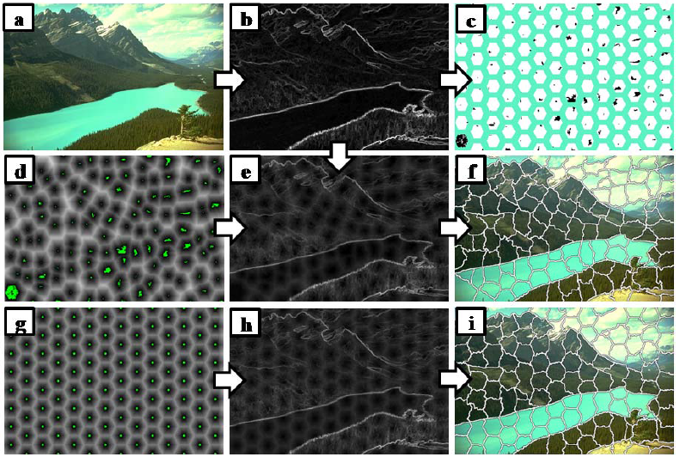
Waterpixel
spatially regularized gradient
[11] Machairas, Vaïa, et al. "Waterpixels." Image Processing, IEEE Transactions on24.11 (2015): 3707-3716.
Notes:
[11] Machairas, Vaïa, et al. "Waterpixels." Image Processing, IEEE Transactions on24.11 (2015): 3707-3716.

Slide 23
Waterpixel
(h) k=0 (i) k=4 (j) k=10
The choice of k is application dependent:
when k equals zero, no regularization of the gradient is applied; when k , we approach the regular grid.
[7] Machairas, V., Etienne Decencìère, and Thomas Walter. "Waterpixels: Superpixels based on the watershed transformation."
Notes:
Waterpixel可以透過調整k來控制superpixel的規律性，: 當k=0，就是原本的gradient，不影響超像素規律性，當 k 越大 , 會越趨近 regular grid.
[7] Machairas, V., Etienne Decencìère, and Thomas Walter. "Waterpixels: Superpixels based on the watershed transformation."

Slide 24
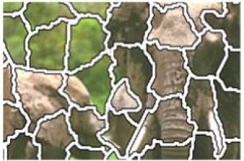
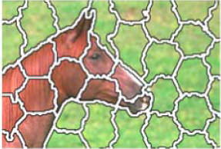
Simulation Results
Fast computation
Regular shape and similar size
Bad adherence to object boundaries
Waterpixel
Waterpixel
[11] Machairas, Vaïa, et al. "Waterpixels." Image Processing, IEEE Transactions on24.11 (2015): 3707-3716.
Notes:
Waterpixel 隨著superpixel 數增加 所花時間跟著增加 但基本上都會比SLIC還快
Waterpixel 的邊界吻合度比SLIC還差

Slide 25
Conclusion
Superpixel methods extract the meaningful regions in the image, and improve the computation based on pixels.
Superpixel methods can be categorized into two types: graph-based methods and gradient-based methods.
Different superpixel methods have different advantages and drawbacks. We should choose the proper method according to the problem.

Slide 26
Reference
[1] Machairas, Vaïa, Etienne Decencière, and Thomas Walter. "Spatial Repulsion Between Markers Improves Watershed Performance." Mathematical Morphology and Its Applications to Signal and Image Processing. Springer International Publishing, 2015. 194-202.
[2] Levinshtein, Alex, et al. "Turbopixels: Fast superpixels using geometric flows."Pattern Analysis and Machine Intelligence, IEEE Transactions on 31.12 (2009): 2290-2297.
[3] Yi, Faliu, and Inkyu Moon. "Image segmentation: A survey of graph-cut methods." Systems and Informatics (ICSAI), 2012 International Conference on. IEEE, 2012.
[4] Liu, Ming-Yu, et al. "Entropy rate superpixel segmentation." Computer Vision and Pattern Recognition (CVPR), 2011 IEEE Conference on. IEEE, 2011.
[5] Shi, Jianbo, and Jitendra Malik. "Normalized cuts and image segmentation."Pattern Analysis and Machine Intelligence, IEEE Transactions on 22.8 (2000): 888-905.
[6] Achanta, Radhakrishna, et al. "SLIC superpixels compared to state-of-the-art superpixel methods." Pattern Analysis and Machine Intelligence, IEEE Transactions on 34.11 (2012): 2274-2282.

Slide 27
[7] Machairas, V., Etienne Decencìère, and Thomas Walter. "Waterpixels: Superpixels based on the watershed transformation." Image Processing (ICIP), 2014 IEEE International Conference on. IEEE, 2014.
[8] http://www.lunwen365.com/qitaleibie/lunwenzhidao/fanli/563192.html
[9] http://m.blog.csdn.net/blog/Guzenyel/25769507
[10] Peng, Bo, Lei Zhang, and David Zhang. "A survey of graph theoretical approaches to image segmentation." Pattern Recognition 46.3 (2013): 1020-1038.
[11] Machairas, Vaïa, et al. "Waterpixels." Image Processing, IEEE Transactions on24.11 (2015): 3707-3716.

